Slide 1


Cristian Antonio Wieczorek Villas Boas, Ph.D.
April 8, 2024

Slide 2

Outline
This presentation is divided into:
Executive Summary
Introduction
Methodology
Results
Conclusion
Appendix

Slide 3
Executive Summary
Using Data Science to Improve the Success Rate of Future Space Missions
Problem Statement:
Between 2010 and 2013, all SpaceX landing missions failed. Although the success rate started to improve in 2014, it did not reach 100% until 2021. The objective is to achieve a 100% success rate for landing missions.
Methodology and Proposed Solution:
Data science techniques were used to develop the best classification model to predict the landing outcome based on payload mass, orbit, launching site, and booster. To achieve this, the data was processed, missing values were removed, and a new table was created using SQL before applying classification models. The analysis demonstrated that the Decision Tree is the best classification model to predict outcomes with an accuracy of 88%, a sensitivity of 100%, a specificity of 92%, and a precision of 83%.
Final Thoughts and Next Steps:
The current analysis will be used to decide which launch site, payload mass, orbit, and booster should be used to achieve a successful landing outcome. Future steps include implementing the insights gained from this analysis to improve the success rate of landing missions in the future.
Repository: https://github.com/cristianwvboas/Data-Science-Capstone-Project-SpaceX

Slide 4
Introduction
Project Background:
The aim of this project is to gather data on SpaceX launch missions from the web, rectify any missing data, and employ various tools such as Pandas, NumPy, SQL, Dash, and Classification Models to determine the most accurate model that can explain the landing mission outcome.
Problems to Address:
Using the aforementioned tools, we intend to develop a model that can successfully classify true positives, true negatives, false negatives, and false positives. This will enable us to make informed decisions for future missions based on key factors such as payload mass, booster, orbit, and launching site.

Slide 5

Section 1

Slide 6
Methodology
Executive Summary
Data collection methodology:
Data was collected in two ways, from an API and web scraping (Wikipedia)
Perform data wrangling
That information is located on slide #10 in the flowchart format
Perform exploratory data analysis (EDA) using visualization and SQL
Perform interactive visual analytics using Folium and Plotly Dash
Perform predictive analysis using classification models

Slide 7
Data Collection
Describe how data sets were collected.
You need to present your data collection process use key phrases and flowcharts

Slide 8
Data Collection – SpaceX API
Import Libraries (Pandas, NumPy, requests, and datetime
Defined as SpaceX as name to call the API website
Create a response = requests.get(SpaceX)
Normalize the response to json using response.json()
Define a name for your df and pass the previous objected to pd.json_normalize()
And Call your df by the name you defined in the previous step, i.e. df.head(5)
Create a series of helper functions that will help when you call the API
https://github.com/cristianwvboas/Data-Science-Capstone-Project-SpaceX/blob/main/1.jupyter-labs-spacex-data-collection-api.ipynb

Slide 9
Data Collection - Scraping
Install/import libraries (sys, request, beautiful soups, re, unicodedata, and pandas)
Create helper functions to process web scraped HTML table
Assign the URL of desire to an object
Perform a HTTP GET method to request the HTML page
Create a Beatufilsoup object from the HTML response
Assign ‘tables’ as soup object and find all table headers with soup.find_all() and assign the results to a list
Find the table of interest and call it from the list, i.e. my_table = tables[]
Create an empty list column_names[] and iterate each ‘th’ element appending to column_names list
Create an empty dictionary with keys extracted from column_names with dict.fromkeys(column_names)
Initialize a list to store all launch dictionaries.
Then iterate for each row the table using soup.find_all(‘tr’). After that, append the launch dictionary to the list of interest
Print the df and save the csv file
https://github.com/cristianwvboas/Data-Science-Capstone-Project-SpaceX/blob/main/2.jupyter-labs-webscraping.ipynb

Slide 10
Data Wrangling
Import pandas and numpy libraries
Load your spaceX dataset to a df object with pd.read_csv()
Identify and calculate the % of missing values to each attribute
Identify which columns are numerical and categorical with df.types
Check for different launch sites, orbits, and landing outcomes
Create a set of outcomes where you can classify as good or bad
Create an empty list for landing_class and append 0 as bad outcome, else ==1
Assign a ‘Class’ column to landing_class and call the df again to check the new column
Save the csv file with df.to_csv()
https://github.com/cristianwvboas/Data-Science-Capstone-Project-SpaceX/blob/main/3.labs-jupyter-spacex-Data%20wrangling.ipynb

Slide 11
EDA with Data Visualization
To visualize the SpaceX data it was picked some charts:
Scatters charts:
Outcome (success or fail) of the missions according to the weight and mission number
Relationship between flight number and launch site, also classified by the mission outcome
Relationship between payload and launch site, also classified by mission outcome
Relationship between orbit type and flight number, classified by mission outcome
Relationship between Payload and Orbit type, classified by mission outcome
Bar graphic:
Showing mission success rate according to the orbit
Line Chart:
Success Launch rate across the years, showing the success rate increased across the years
https://github.com/cristianwvboas/Data-Science-Capstone-Project-SpaceX/blob/main/5.jupyter-labs-eda-dataviz.ipynb

Slide 12
EDA with SQL
First step: Importing pandas, csv, ipython-sql, and sqlite3 packages
Second step: Create a connection with SQL and a cursor object
Third step: Create a SQL magic line
Fourth step: Create a df object passing ‘pd.read_csv( )’ and ‘df.to_sq( )l’ in sequence. Finally, calling the df
Fifth step: Create a SPACEXTABLE table with SQL using ‘as SELECT* from Spacextbl’ and passing where the date is not null to eliminate null entries
Sixth step: Use the queries of interest. For example:
finding launch sites: Select distinct Launch_Site as ‘Launch Sites’
Other SQL queries can be found at the appendix as snipets
https://github.com/cristianwvboas/Data-Science-Capstone-Project-SpaceX/blob/main/4.jupyter-labs-eda-sql-coursera_sqllite.ipynb

Slide 13
Build an Interactive Map with Folium
A Folium map was created, and marks were added to show launching sites. Zooming on the map, the user can look for more details for each launch site and observe the successful and failed missions. Also, for the site, CCAFS LSC-40 lines and distance were added from launch positions to highway, railway, and coastline. More detailed info and maps can be found on slides #34-37
https://github.com/cristianwvboas/Data-Science-Capstone-Project-SpaceX/blob/main/6.lab_jupyter_launch_site_location.ipynb

Slide 14
Build a Dashboard with Plotly Dash
A dashboard with Plotly Dash was created. In summary, pie charts were created to demonstrate the percentage of successful missions per launching site. A Scatter chart was designed to show the mission's outcome based on payload mass, booster, and launching site. More detailed info can be found on slides #38-41.
https://github.com/cristianwvboas/Data-Science-Capstone-Project-SpaceX/blob/main/7.spacex_dash_app.py

Slide 15
Predictive Analysis (Classification)
Four classification models were used with SpaceX data to predict outcomes: logistic regression, support machine vector, decision trees, and KNN. A chart comparing the accuracy of those predictive analyses was built. More detailed information and the best classification model can be found on slides # 42-44
https://github.com/cristianwvboas/Data-Science-Capstone-Project-SpaceX/blob/main/8.SpaceX_Machine%20Learning%20Prediction_Part_5.ipynb

Slide 16
Results
Exploratory data analysis results
Interactive analytics demo in screenshots
Predictive analysis results

Slide 17

Section 2

Slide 18
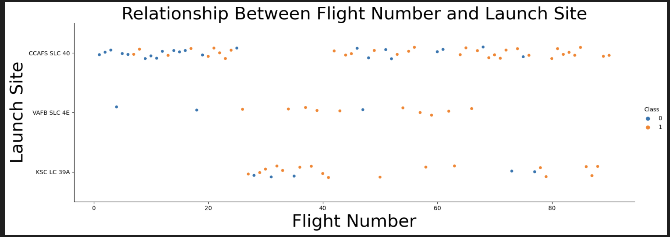
Flight Number vs. Launch Site
Show a scatter plot of Flight Number vs. Launch Site
Show the screenshot of the scatter plot with explanations

Slide 19
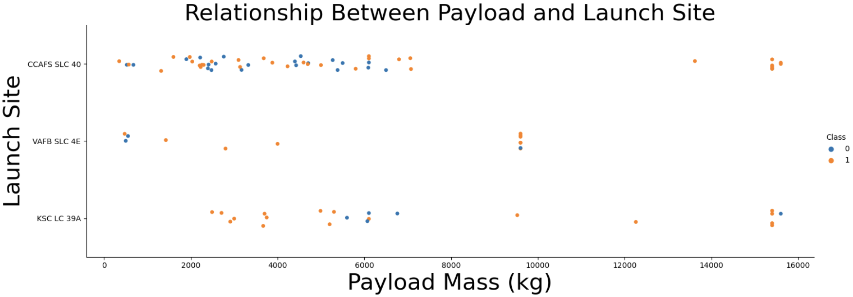
Payload vs. Launch Site
Show a scatter plot of Payload vs. Launch Site
Show the screenshot of the scatter plot with explanations

Slide 20
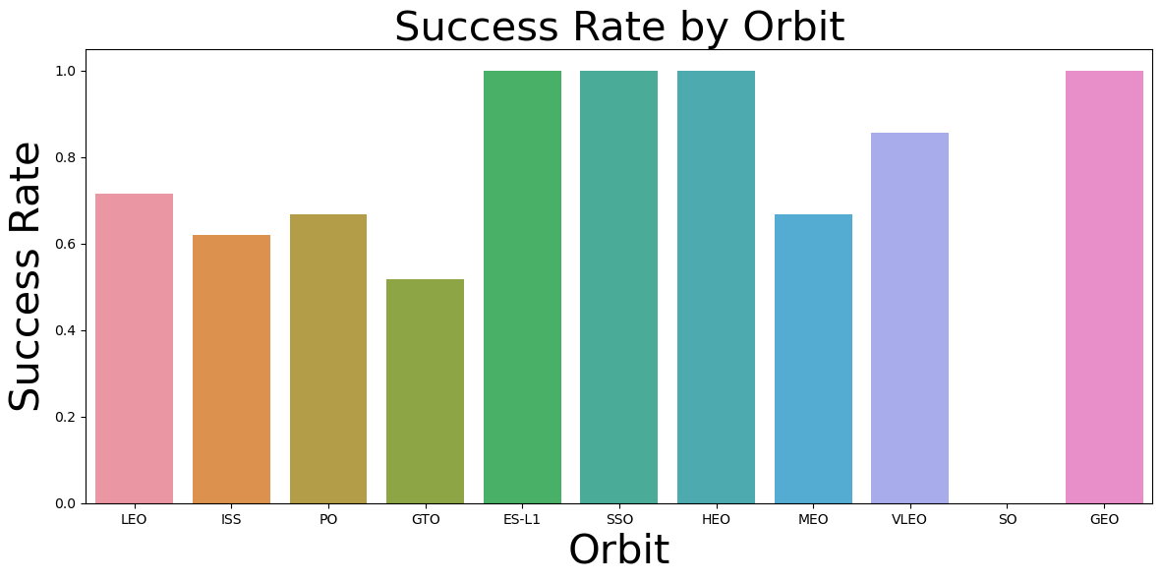
Success Rate vs. Orbit Type
Show a bar chart for the success rate of each orbit type
Show the screenshot of the scatter plot with explanations

Slide 21
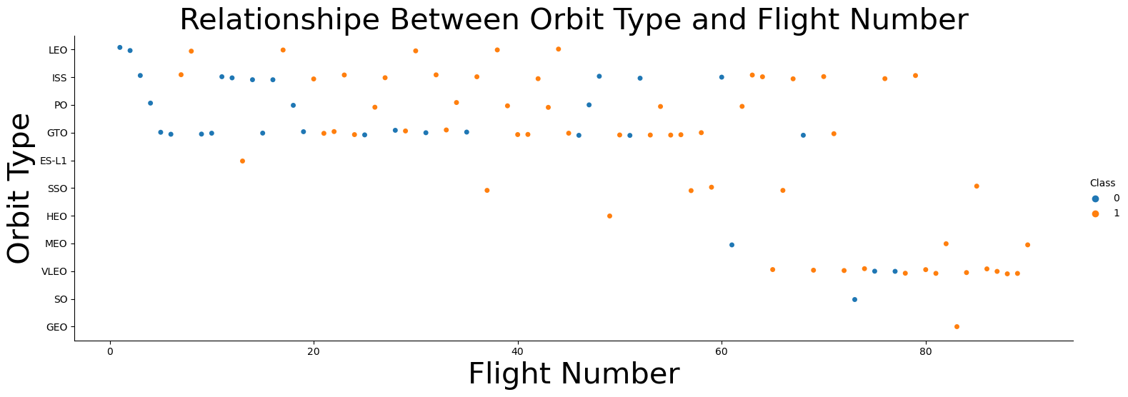
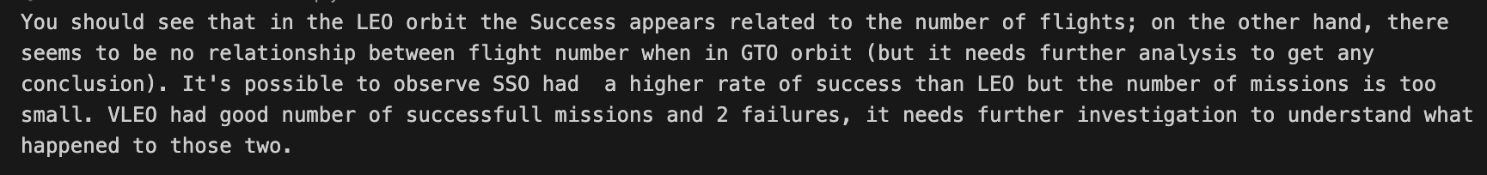
Flight Number vs. Orbit Type
Show a scatter point of Flight number vs. Orbit type
Show the screenshot of the scatter plot with explanations

Slide 22
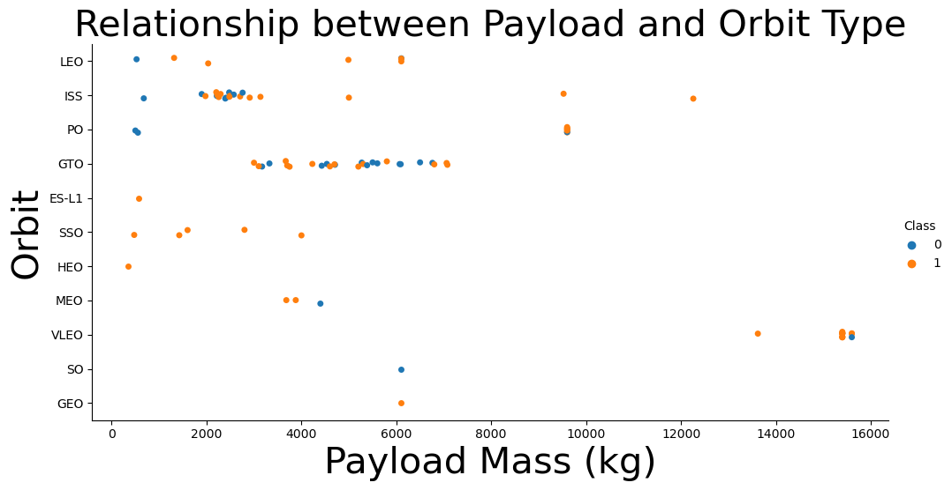
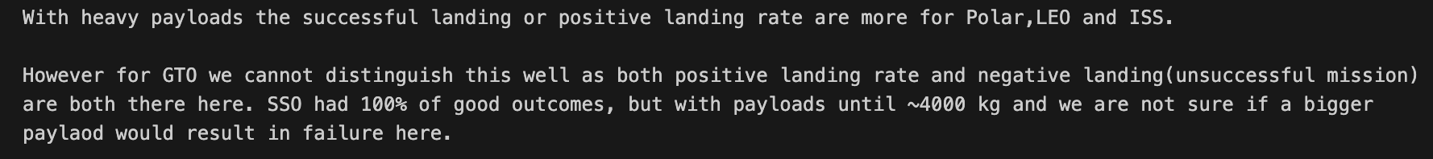
Payload vs. Orbit Type
Show a scatter point of payload vs. orbit type
Show the screenshot of the scatter plot with explanations

Slide 23
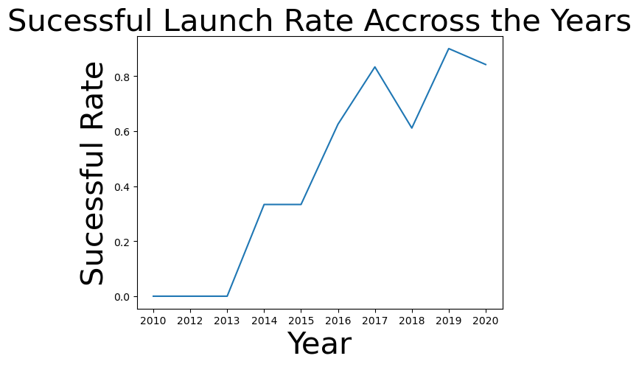
Launch Success Yearly Trend
Show a line chart of yearly average success rate
Show the screenshot of the scatter plot with explanations

Slide 24
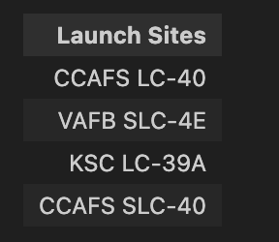
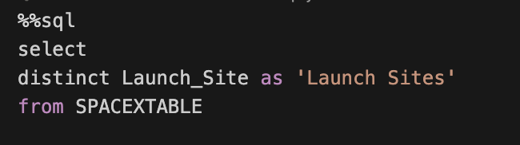
All Launch Site Names
Find the names of the unique launch sites
Present your query result with a short explanation here
This query was used to find distinct ‘values’ for Launch_site in the table ‘SPACEXTABLE’. The result came back as table with one column with title defined with ”as” and four lines of result

Slide 25
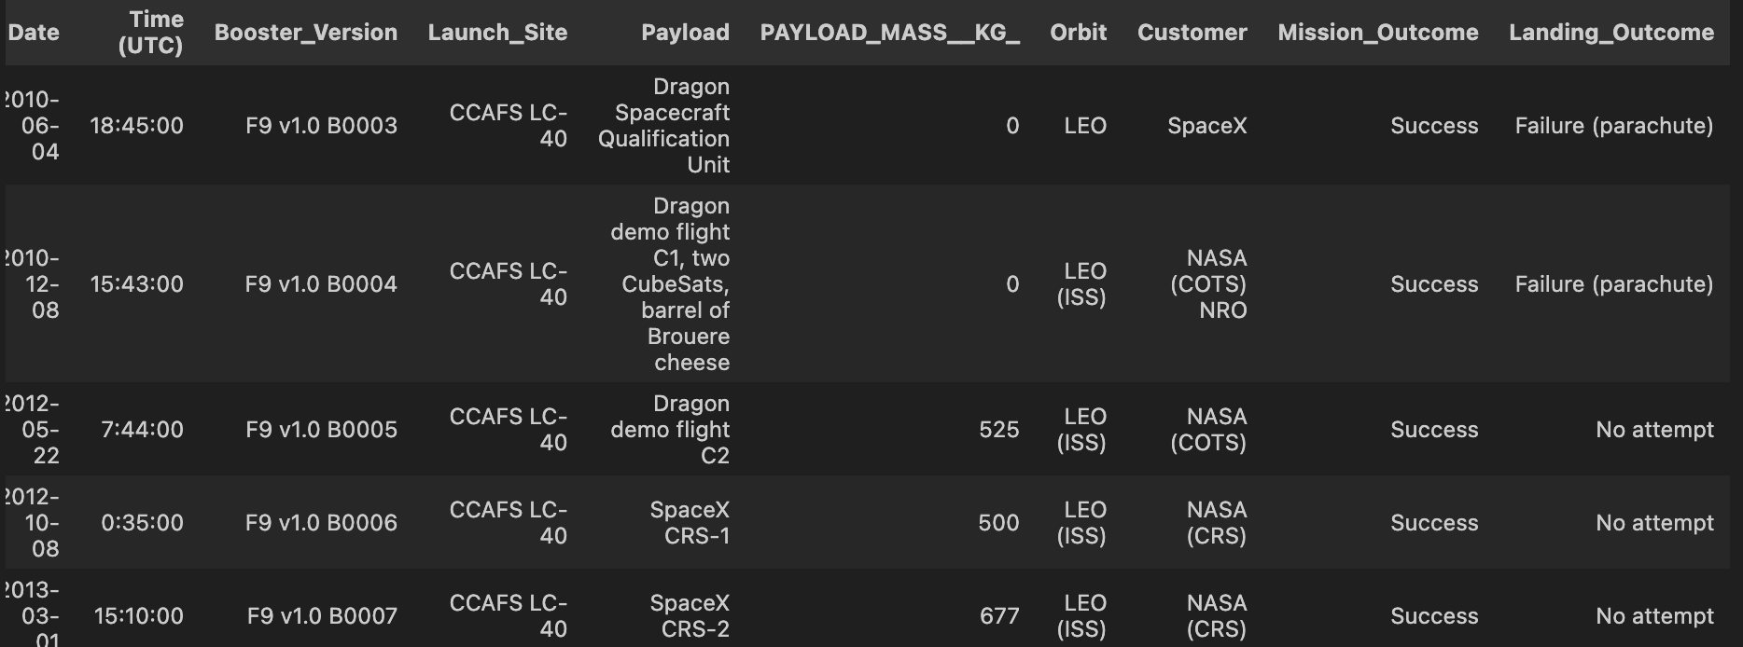
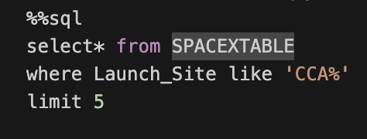
Launch Site Names Begin with 'CCA'
Find 5 records where launch sites begin with `CCA`
Present your query result with a short explanation here
This query selected from the table SPACEXTABLE all entries like CCA%, limiting the result to five. The “%” is used to ‘notify’ the query that you are looking for entries with CCA and other that have more information after CCA

Slide 26
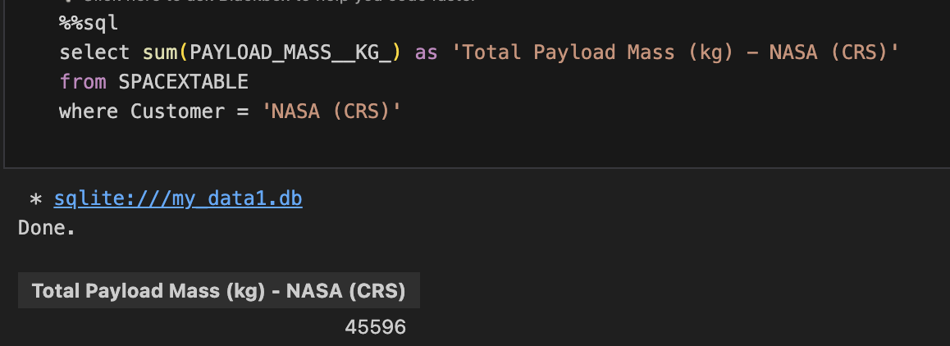
Total Payload Mass
Calculate the total payload carried by boosters from NASA
Present your query result with a short explanation here
This query got the sum all payload mass from the column Payload_Mass__KG_ where the customer was NASA (CRS) according to the instructions.

Slide 27
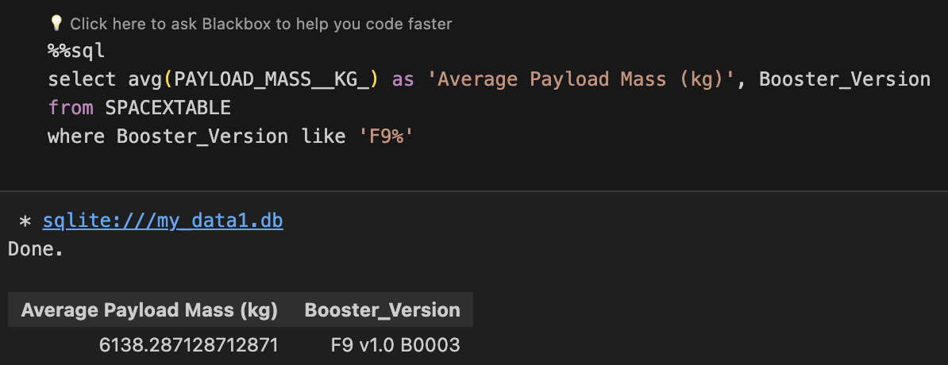
Average Payload Mass by F9 v1.1
Calculate the average payload mass carried by booster version F9 v1.1
Present your query result with a short explanation here
This query obtained the average of payload mass from the booster when the booster version assigned was F9 v1.1

Slide 28
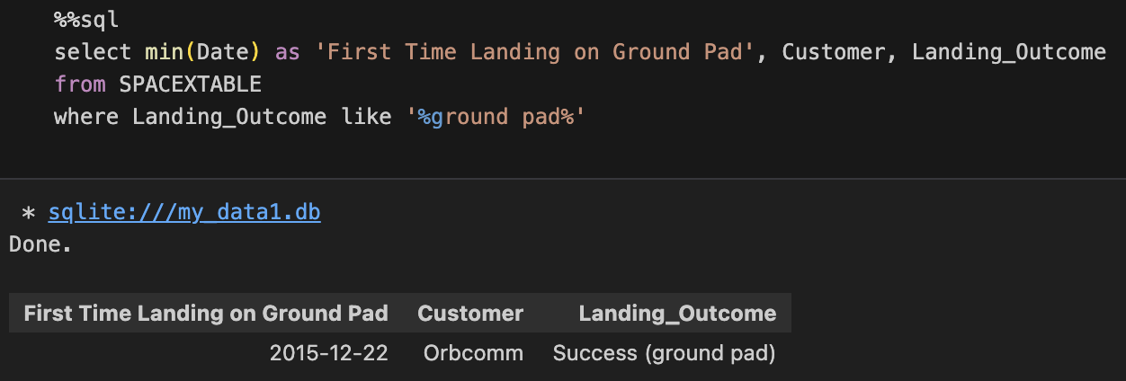
First Successful Ground Landing Date
Find the dates of the first successful landing outcome on ground pad
Present your query result with a short explanation here
This query retrieved the first time a mission was successful in landing on ground pad. However since there was a word before ground pad a “%” was added before ground pad, so the query would return the correct data. In addition, the client was also retrieved from this query

Slide 29
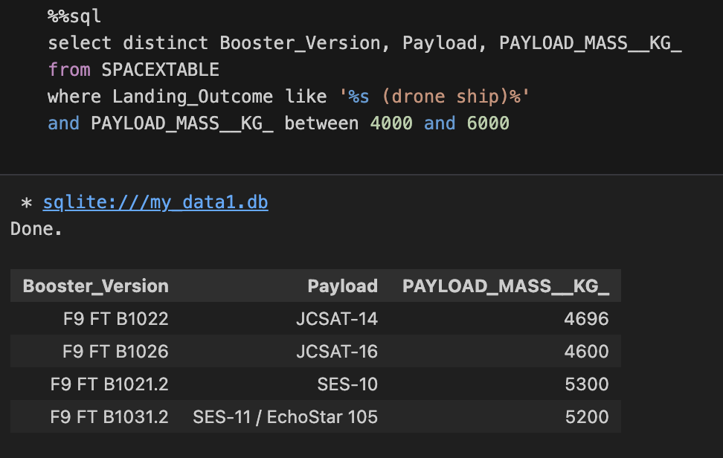
Successful Drone Ship Landing with Payload between 4000 and 6000
List the names of boosters which have successfully landed on drone ship and had payload mass greater than 4000 but less than 6000
Present your query result with a short explanation here
This query selected the columns “Booster_version”, ”payload”, and “Payload_MASS__KG_” from SPACEXTABLE using distinct to avoid counting more than one. Then, where clause was used to find the words ”drone ship” and defined the interval for payload mass

Slide 30
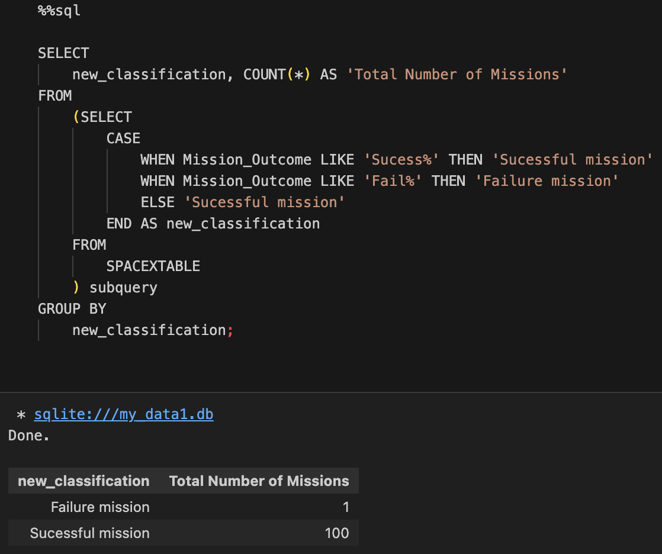
Total Number of Successful and Failure Mission Outcomes
Calculate the total number of successful and failure mission outcomes
Present your query result with a short explanation here
This query created a new classification as failure or successful mission where CASE was used to classify the entries according to the finds, i.e. if the mission was classified before as fail, then it was added to the new classification as Failure mission. The same goes for successful outcomes. Then, it was grouped and counted

Slide 31
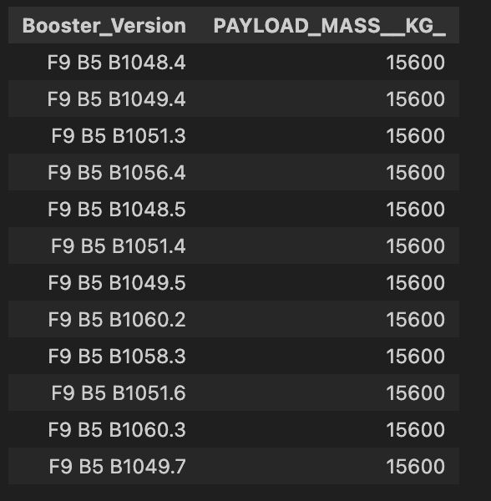
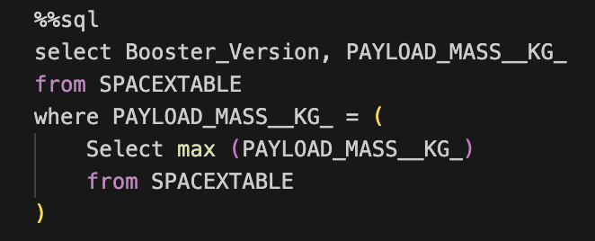
Boosters Carried Maximum Payload
List the names of the booster which have carried the maximum payload mass
Present your query result with a short explanation here
This query selected booster version and payload mass where the maximum entry for each booster version was found

Slide 32
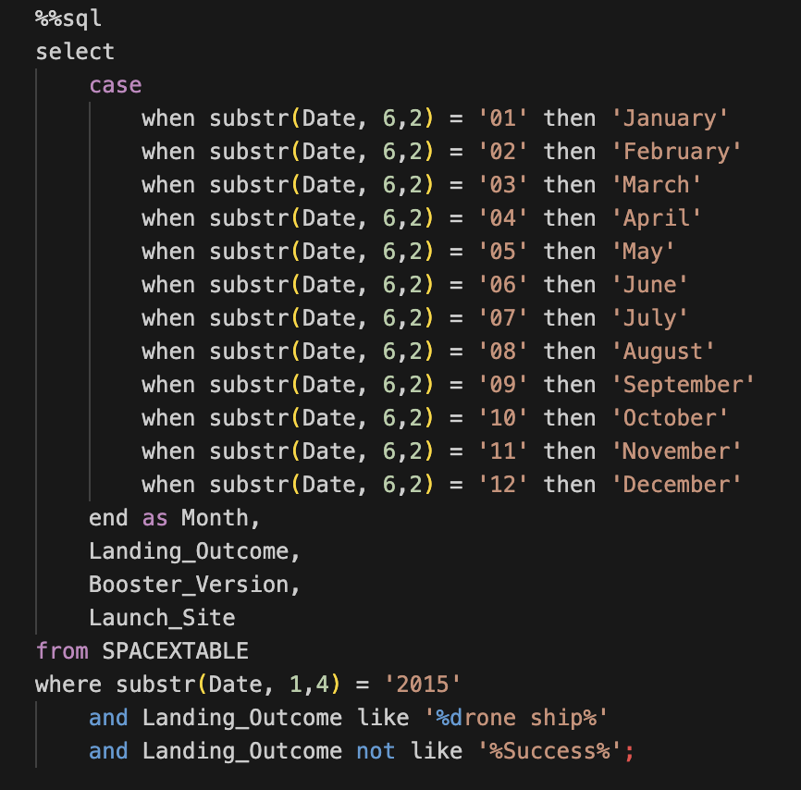
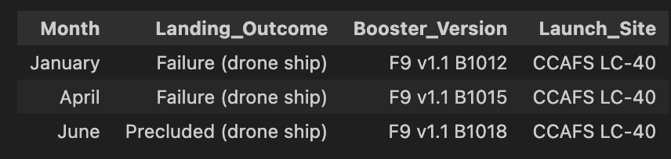
2015 Launch Records
List the failed landing_outcomes in drone ship, their booster versions, and launch site names for in year 2015
Present your query result with a short explanation here
This query used CASE to select the months of a year and then pass it to landing outcome to retrieve the failure outcomes. It was also got the information for booster version and launch site

Slide 33
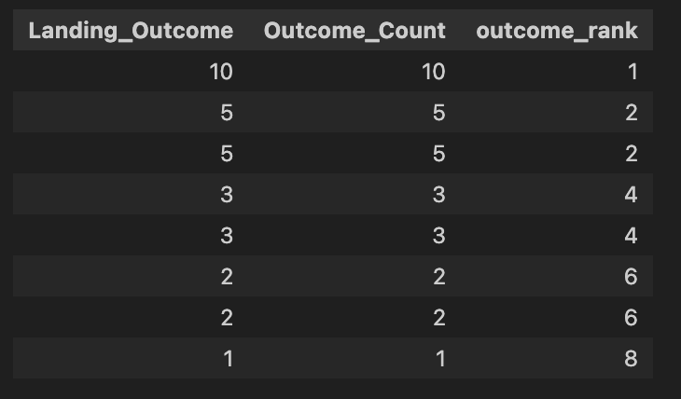
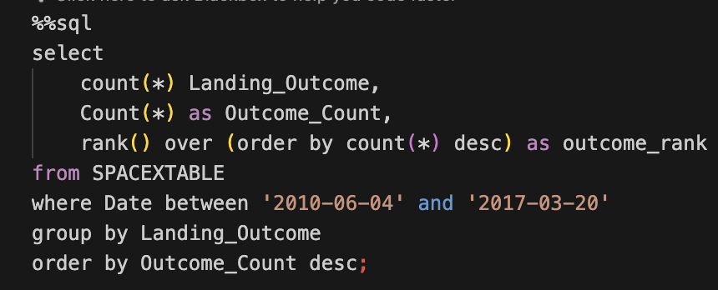
Rank Landing Outcomes Between 2010-06-04 and 2017-03-20
Rank the count of landing outcomes (such as Failure (drone ship) or Success (ground pad)) between the date 2010-06-04 and 2017-03-20, in descending order
Present your query result with a short explanation here
This query counted the landing outcome, ordering by descent and ranking them from the selected dates

Slide 34

Section 3

Slide 35
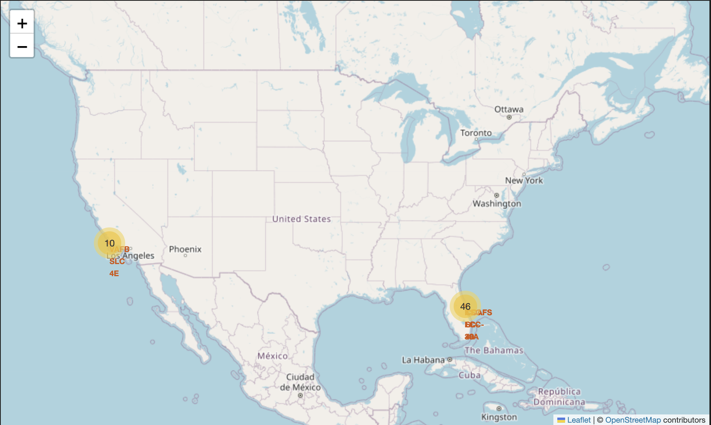
Folium Map showing all SpaceX launch sites
This map demonstrates all SpaceX launch sites in the US. It’s possible to visualize the sites on both coasts and their names
https://github.com/cristianwvboas/Data-Science-Capstone-Project-SpaceX/blob/main/6.lab_jupyter_launch_site_location.ipynb

Slide 36
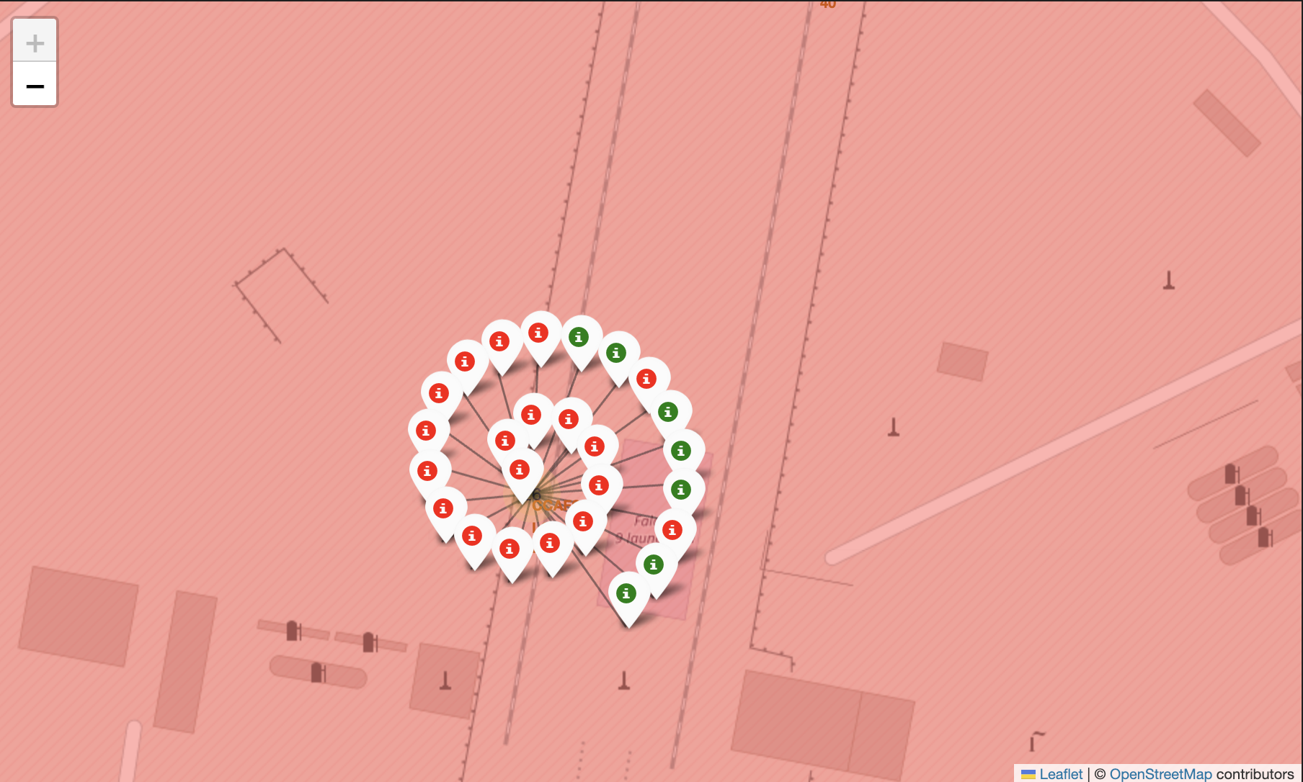
Folium Map of SpaceX launch site CCAFS LC-40 with outcomes
This map demonstrates SpaceX launch site CCAFS LC-40 with outcomes. Red represents a bad outcome, and green represents a good outcome

Slide 37
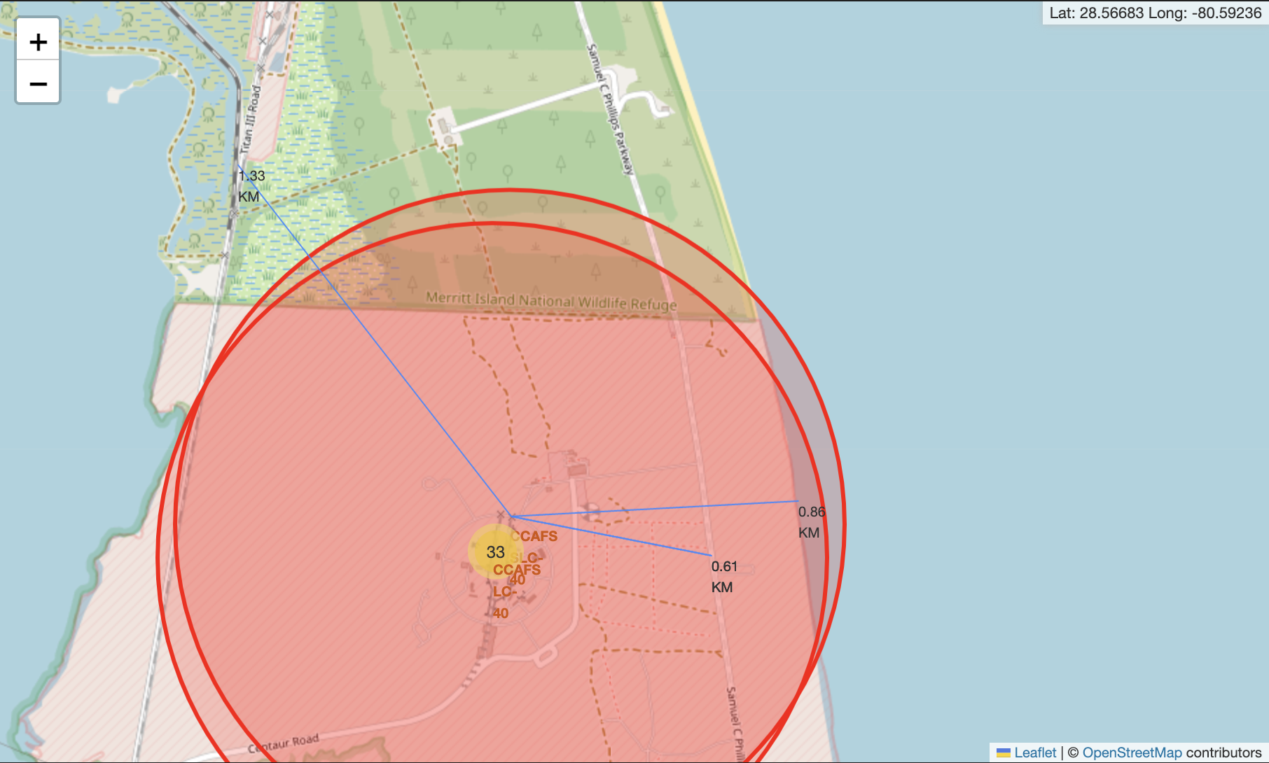
Folium Map with coordinates and distance to points of interest
This map illustrates the SpaceX launch site CCAFS SLC-40 and lines with distances to some point of interest. This application is important to elucidate distance from important marks in your map

Slide 38

Section 4

Slide 39
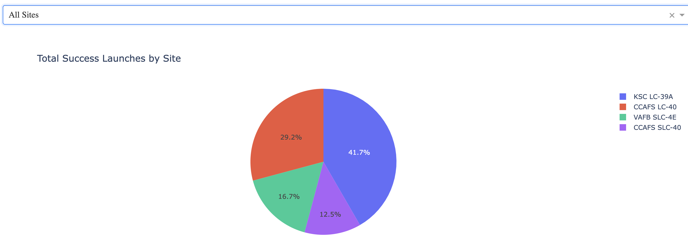
Total Success Launches by Site
This pie chart demonstrates the percentage of successful launches per site. This is important because you can conclude which site could be more successful in future missions if conditions of the missions continues the same
https://github.com/cristianwvboas/Data-Science-Capstone-Project-SpaceX/blob/main/7.spacex_dash_app.py

Slide 40
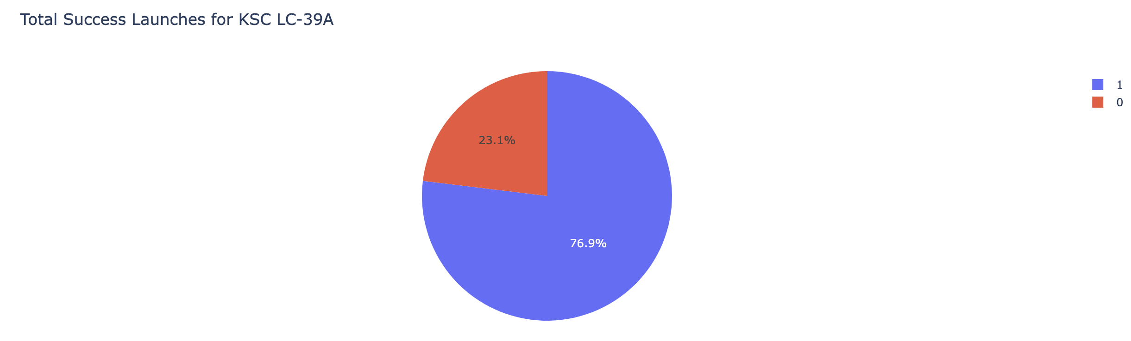
Total Success Launches for KSC LC-39A
This pie chart illustrates the percentage of successful and failed missions for site KSC LC-39A. For this specific site, the success rate was 76.9%, the highest among all sites

Slide 41
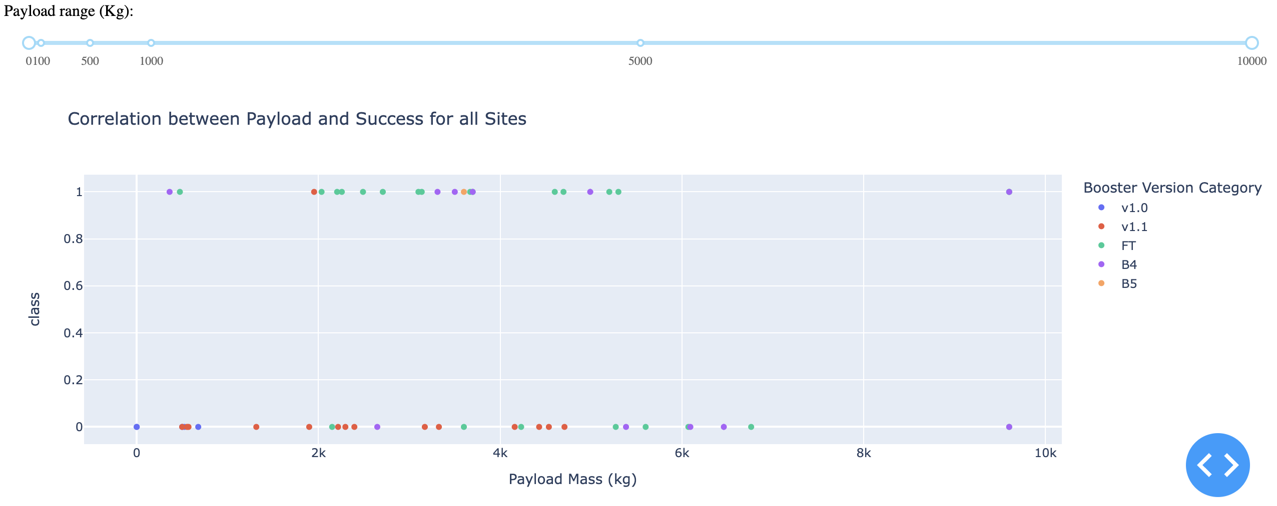
Correlation between Payload and Success for all Sites
In this scatter plot, we observe the successful and failed missions for all sites with different boosters and payloads. This is important because you can use the information to select the best booster for your mission according to payload and launching site

Slide 42

Section 5

Slide 43
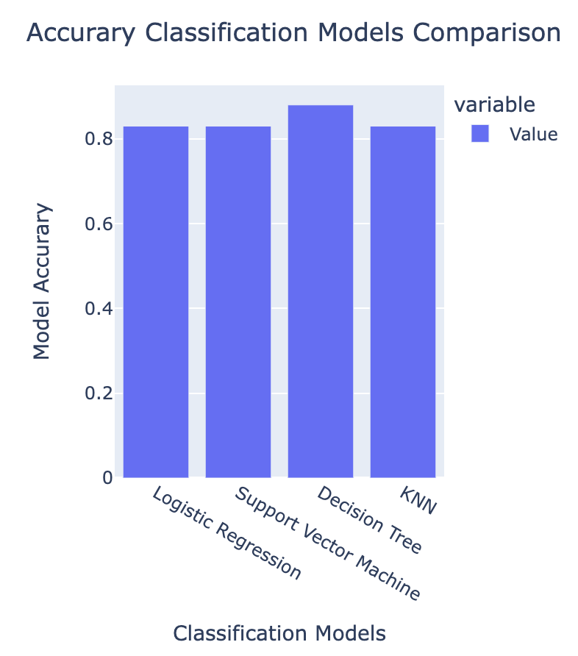
Classification Accuracy
In this bar chart we can observe that the best classification model, based on accuracy, is Decision trees
https://github.com/cristianwvboas/Data-Science-Capstone-Project-SpaceX/blob/main/8.SpaceX_Machine%20Learning%20Prediction_Part_5.ipynb

Slide 44
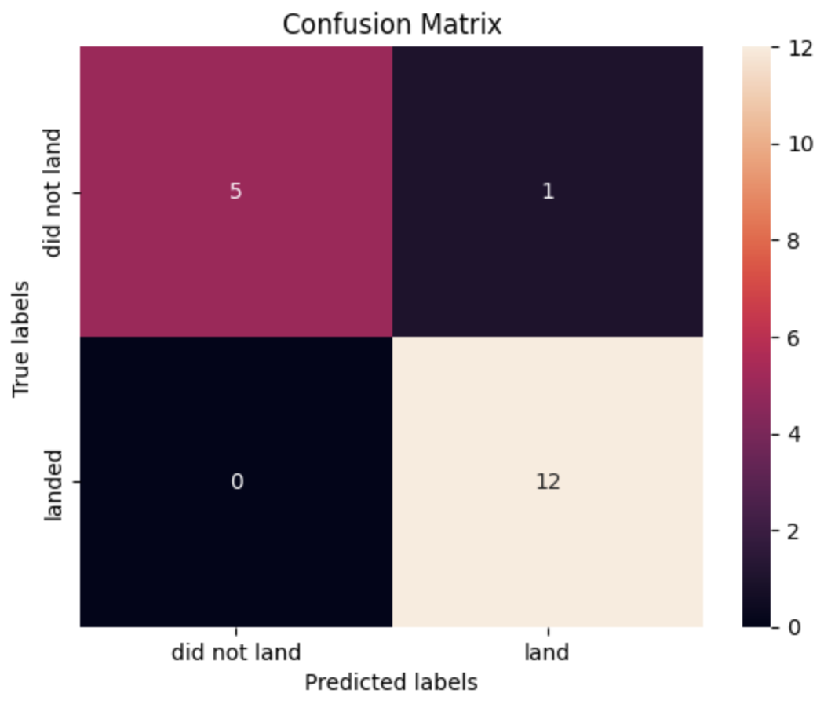
Confusion Matrix
Table 1Comparison of Accuracy, Sensitivity, Specificity, and Precision across the Classification Models
Classification Models | Accuracy | Sensitivity | Specificity | Precision
Logistic Regression | 0.83 | 1.0 | 0.8 | 0.5
Support Vector Machine | 0.83 | 1.0 | 0.8 | 0.5
Decision Tree | 0.88 | 1.0 | 0.92 | 0.83
KNN | 0.83 | 1.0 | 0.8 | 0.5
The table above demonstrates that the best classification model is Decision Tree. This is not based only on the accuracy. The model is superior in specificity (ability to detect true negatives) and precision (positive predictive value).

Slide 45
Conclusions
Decision Tree is the best classification model to predict the outcome of missions
KSC LC-39A has the highest success landing rate
The successful rate for missions in 2021 is approx. 80%
Orbits ES-L1, SSO, HEO, and GEO resulted in best successful rate
KSC LC-39A has 100% positive outcomes for missions with payloads in between 2000 and 5000 kg
CCAFS SCL-40 has 100% positive outcomes for missions with payloads above 7000 kg
The first successful landing mission (ground pad) was on December 22, 2015

Slide 46
Appendix
Datasets created with analysis (added to repository “Data Science Capstone Project SpaceX”) on GitHub:
Dataset_part_1.csv
spacex_web_scraped.csv
Data_part_2.csv
GitHub repository link: https://github.com/cristianwvboas/Data-Science-Capstone-Project-SpaceX

Slide 47
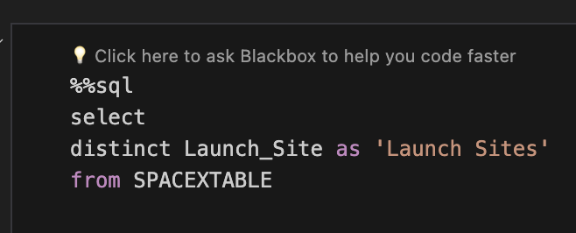
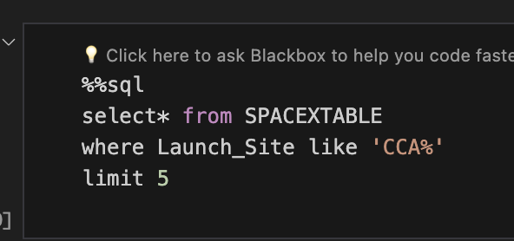
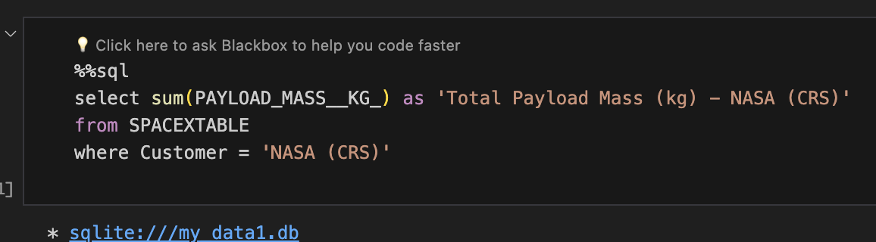
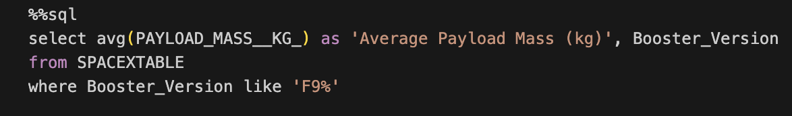
Appendix – SQL code snippets

Slide 48
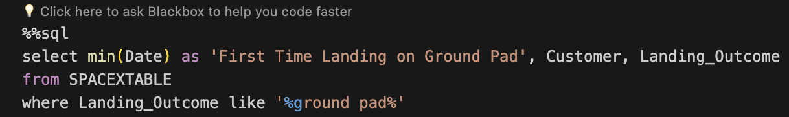
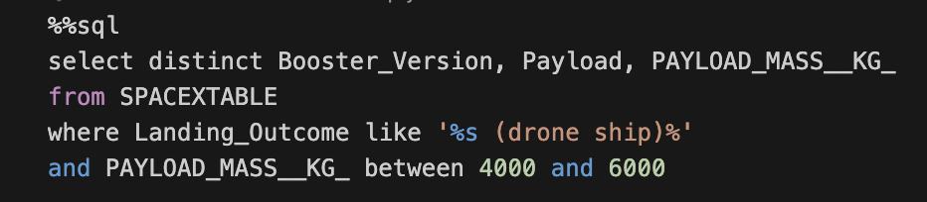
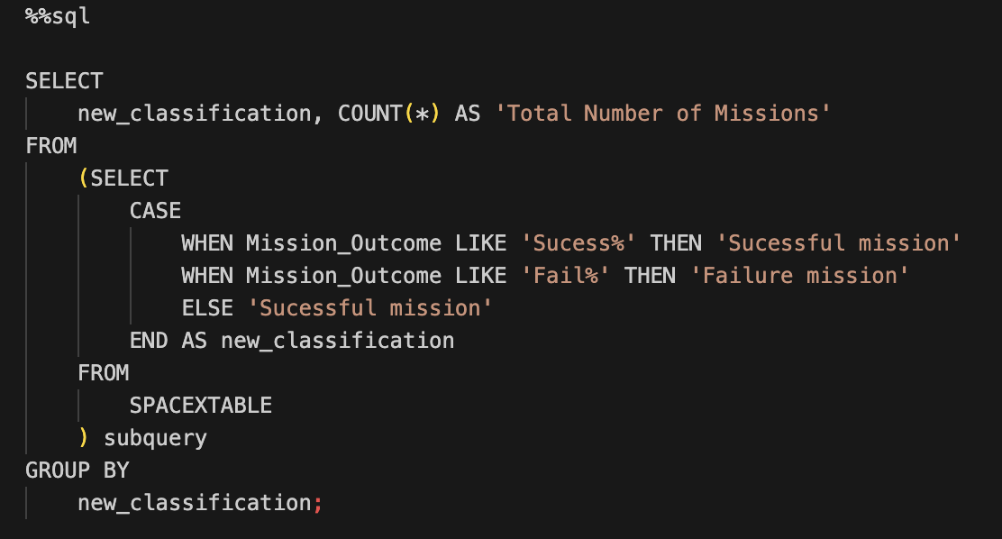
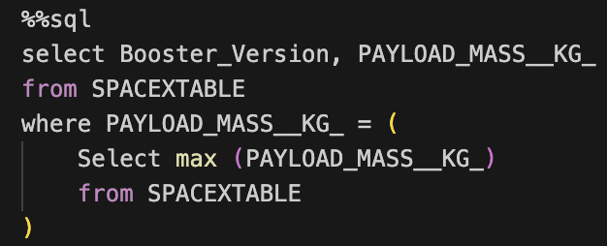
Appendix – SQL code snippets

Slide 49
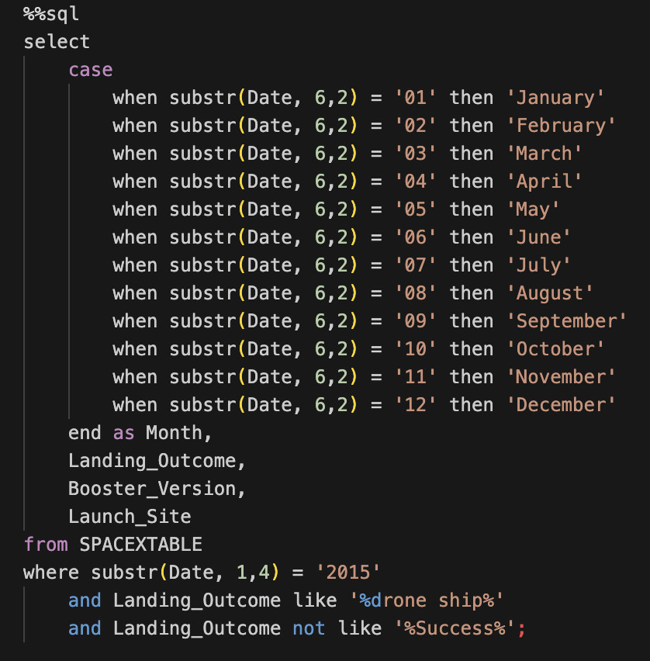
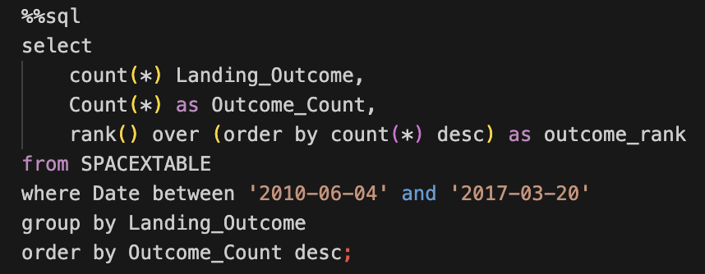
Appendix – SQL code snippets

Slide 50


